Slide 2
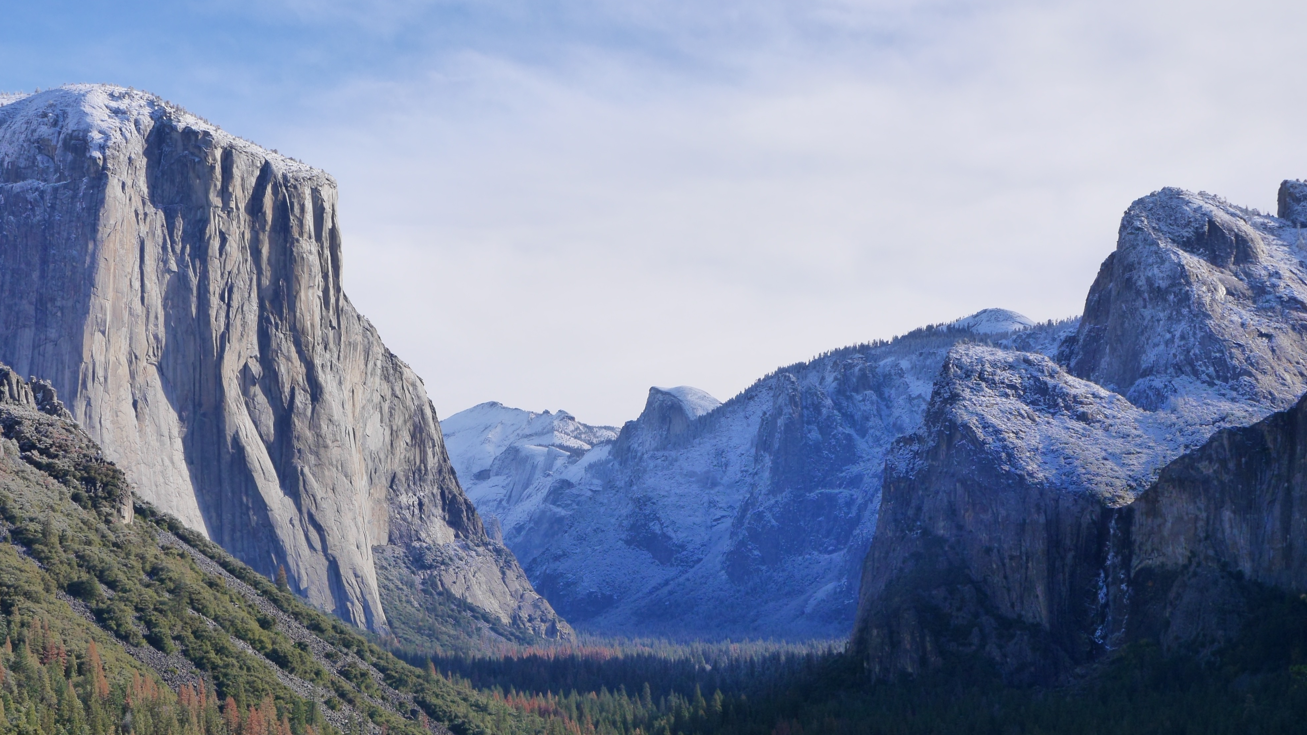
Faith
On Solid Ground
How We Know That Christianity Is True
https://gregenos.org/hillside/

Slide 3
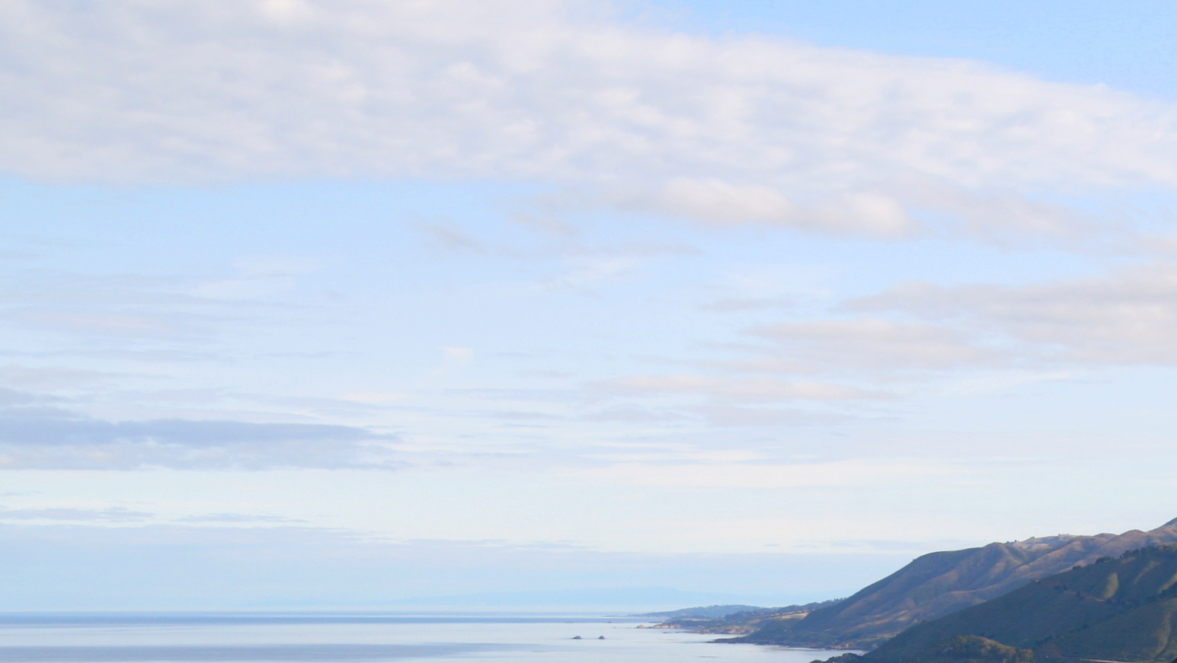
Faith
On Solid Ground
https://gregenos.org/hillside/
Christianity is a trust that God will do what He said He would do, based on good evidence that the entire story is true.

Slide 4
Faith
On Solid Ground
https://gregenos.org/hillside/
7/07/24 The Nature of Truth: What is Truth?
7/14/24 The Evidence for the Existence of God
7/21/24 The Historical Reliability of the New Testament
7/28/24 The Evidence for the Resurrection
8/04/24 How Do We Know the Bible is God’s Word?
8/11/24 Why God Allows Evil

Slide 5
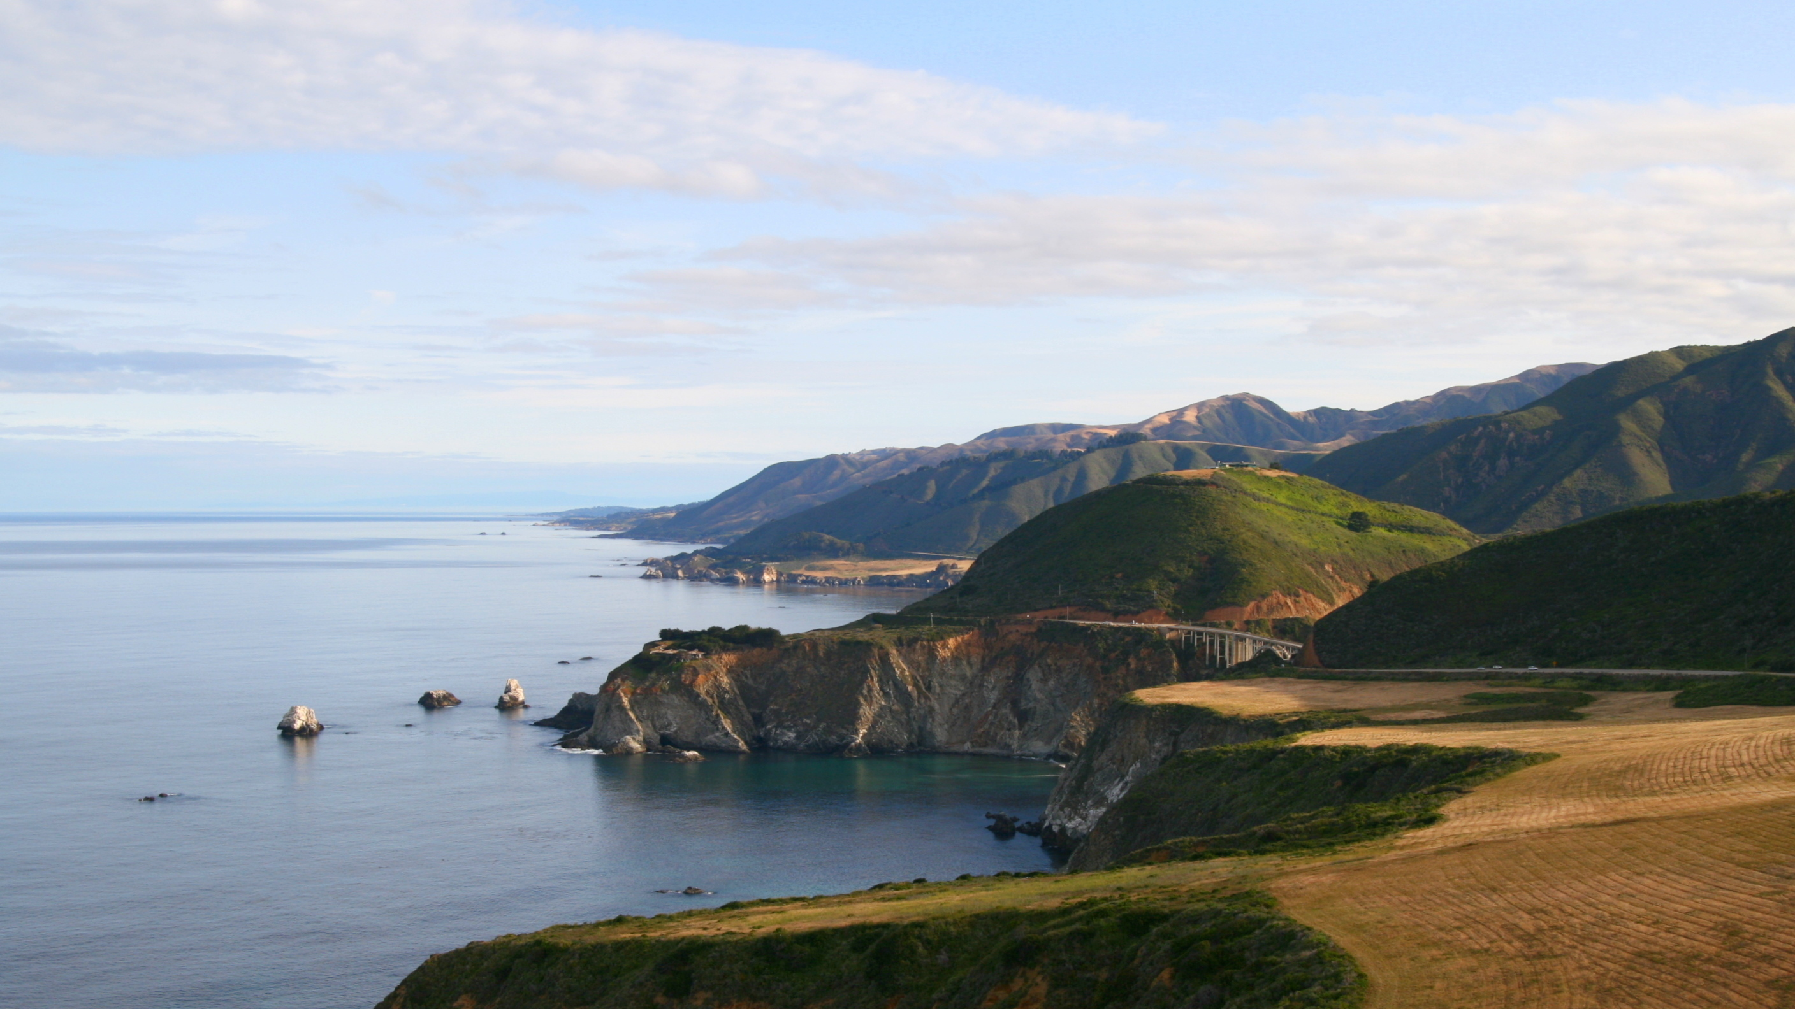
The Historical Reliability of the New Testament

Slide 6
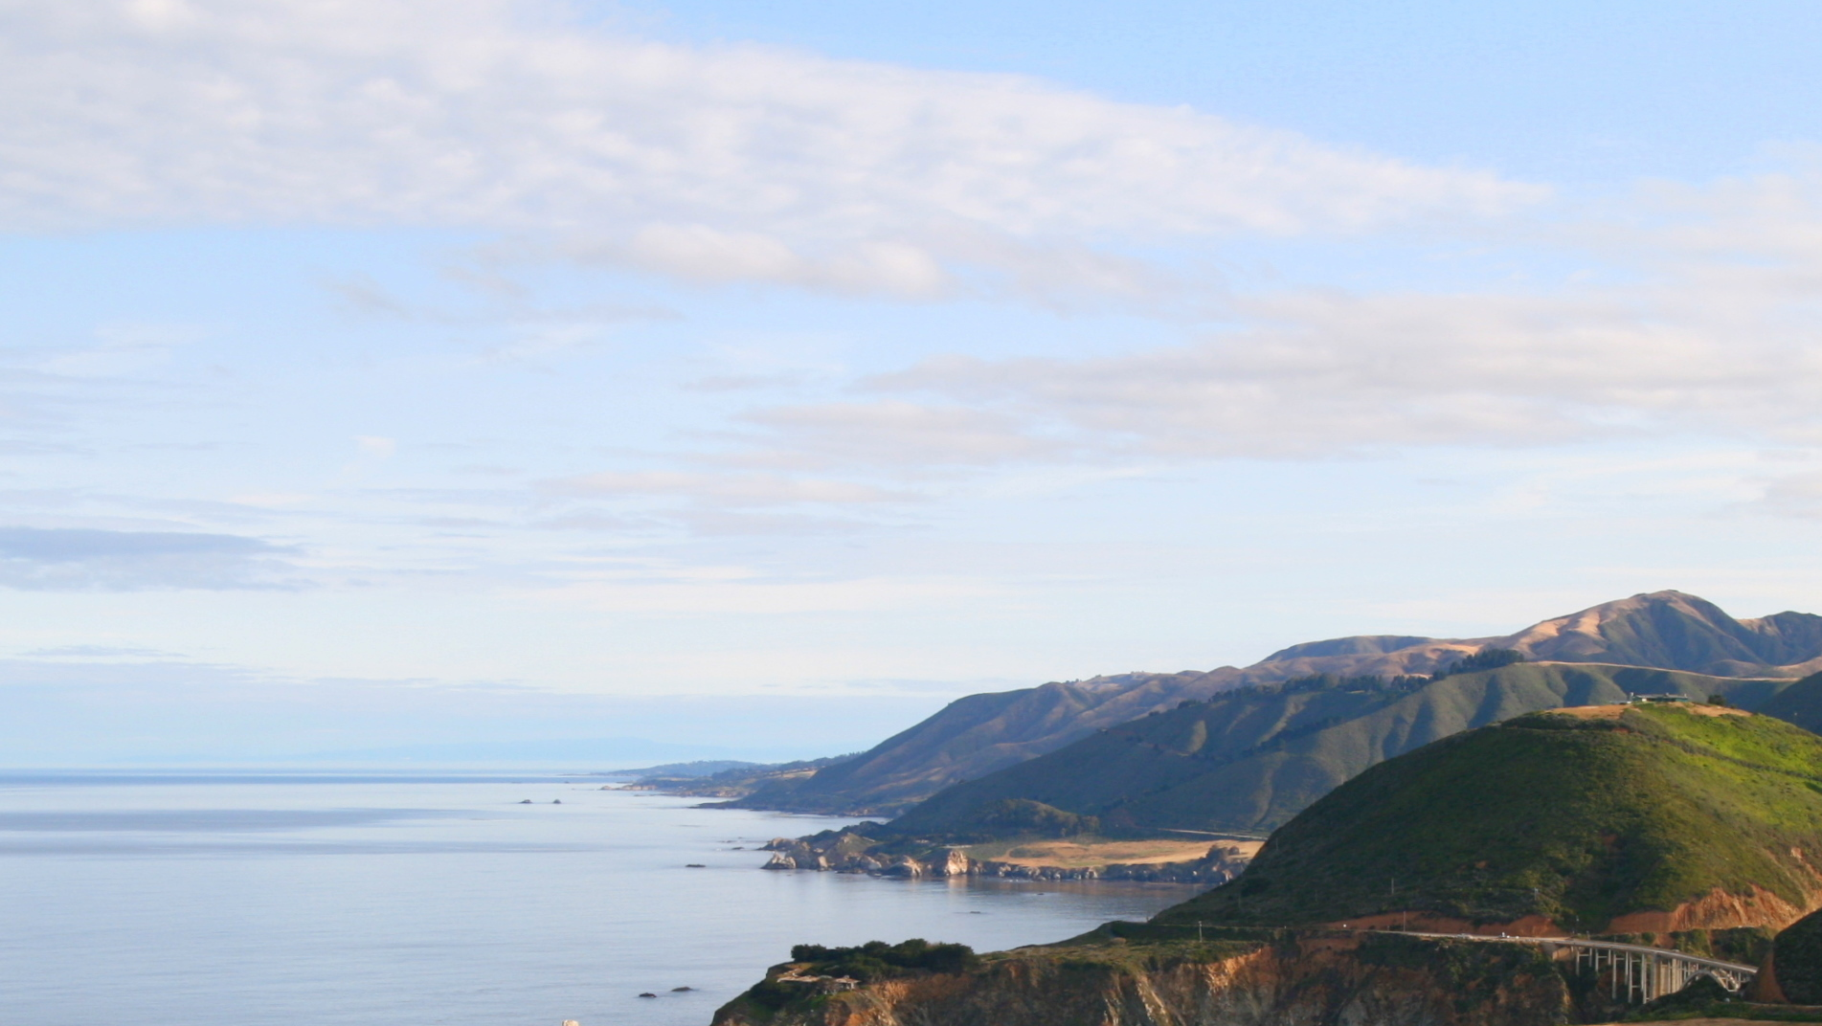
Two Questions
1. Is our New Testament an accurate copy of the original documents?
2. Did the original documents tell the truth?

Slide 7
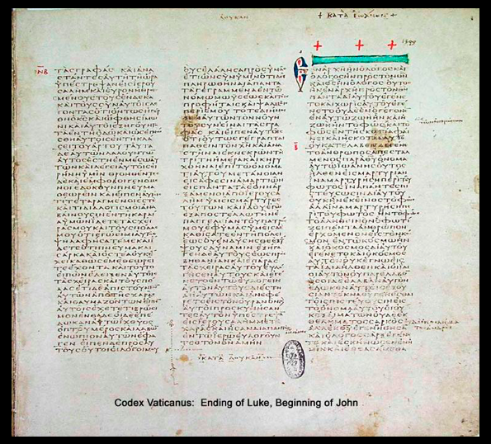
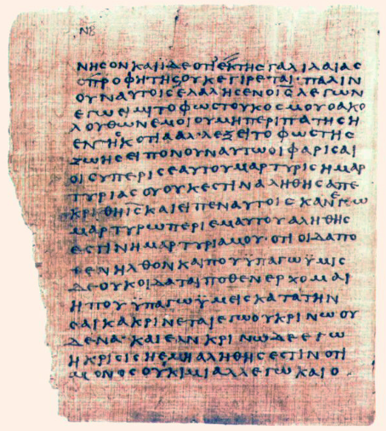
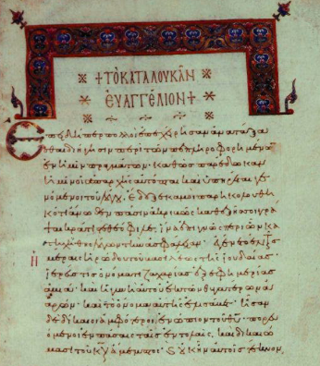
Original Documents
Papyrus
Uncials, or Codex
Minuscules
Printed Bibles

Slide 8
Papyrus
Uncials, or Codex
Minuscules
Printed Bibles

Slide 9
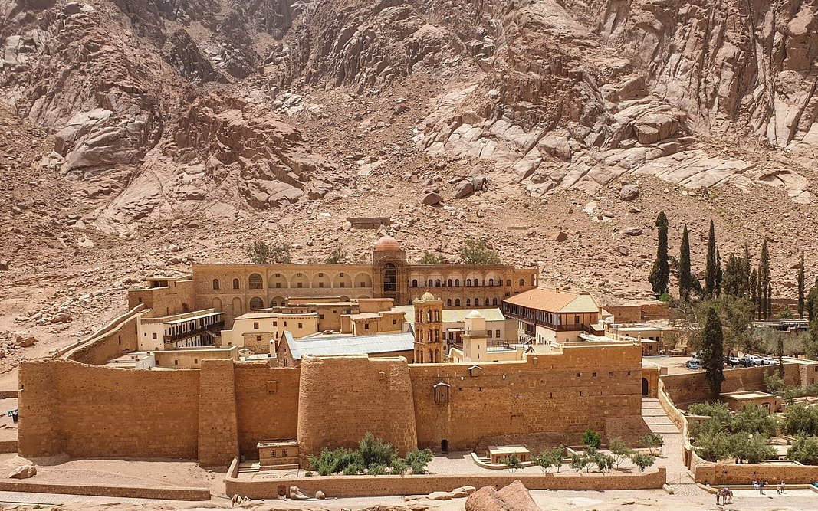
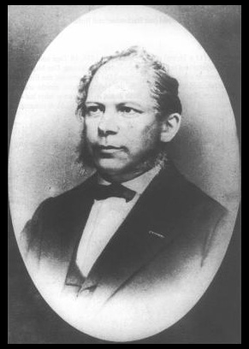
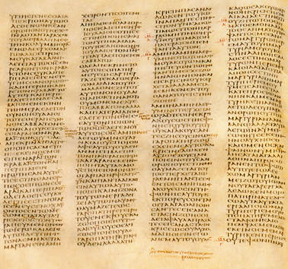
1859
Codex Sinaiticus A.D. 350
Constantin von Tischendorf
1815-1874

Slide 10
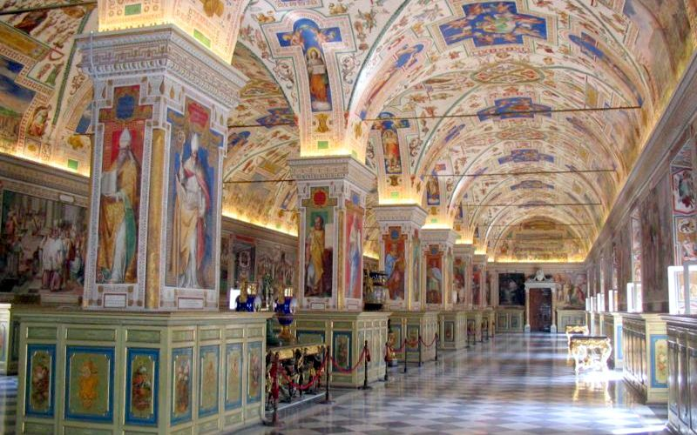
1867
Codex Vaticanus A.D. 325-350

Slide 11
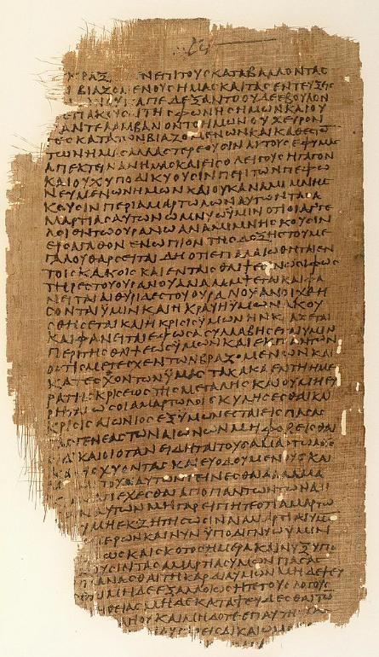
22 Bodmer Papyri
A.D. 200
11 Chester Beatty Papyri
A.D. 155

Slide 12
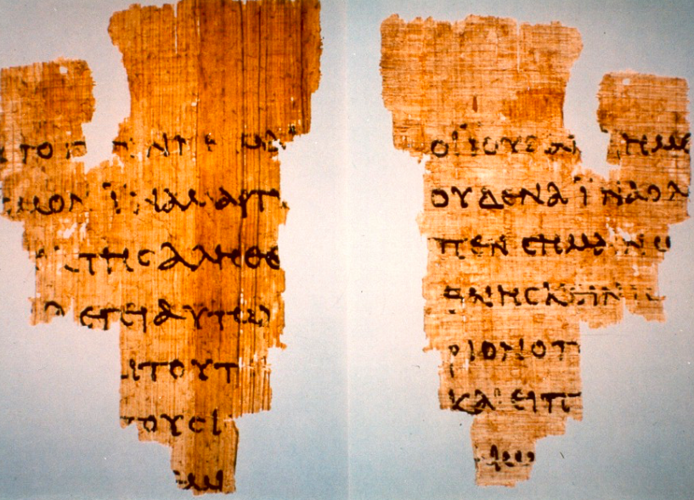
John Rylands Fragment
A.D. 117-138
Notes:
100 papyrus
over 300 uncial
thousands of minuscules

Slide 13
Original Documents
Papyrus
Uncials, or Codex
Minuscules
Printed Bibles

Slide 14
Ancient Document | Time Gap in Years From Original to Copy | Number of Copies
Pliny – Natural History
Caesar – Gallic Wars
Tacitus – History of Roman Empire
Plato
Herodotus — Greek History
Demosthenes – Greek Writer
Homer — Iliad
750
7
1,000
10
1,000
20
1,200
7
1,400
8
1,400
200
400
1,800
Fragments: 50 years
Books: 100 years
Most of NT: 150 years
Complete NT: 225 years
New Testament
5,795
With Latin, Ethiopian, Armenian, Syriac, Coptic, etc. : 25,800
99.5% accuracy, with no effects to any Christian doctrine.

Slide 15
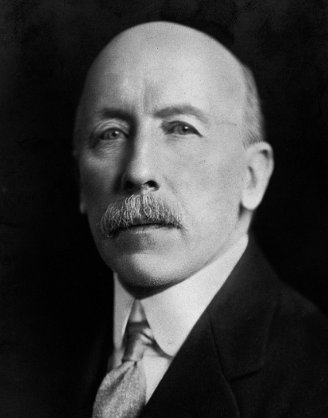
“It cannot be too strongly asserted that… the text of the Bible is certain… The number of manuscripts of the New Testament… is so large that it is practically certain that the true reading is preserved. This can be said of no other ancient book in the world.”
Sir Fredric Kenyon
1863-1952
Biblical and classical Scholar,
Director, British Museum

Slide 16
“The interval then between the dates of original composition and the earliest [manuscripts] becomes so small as to be in fact negligible, and the last foundation for any doubt that the Scriptures have come down to us substantially as they were written has now been removed.”
Sir Fredric Kenyon
1863-1952
Biblical and classical Scholar,
Director, British Museum

Slide 17
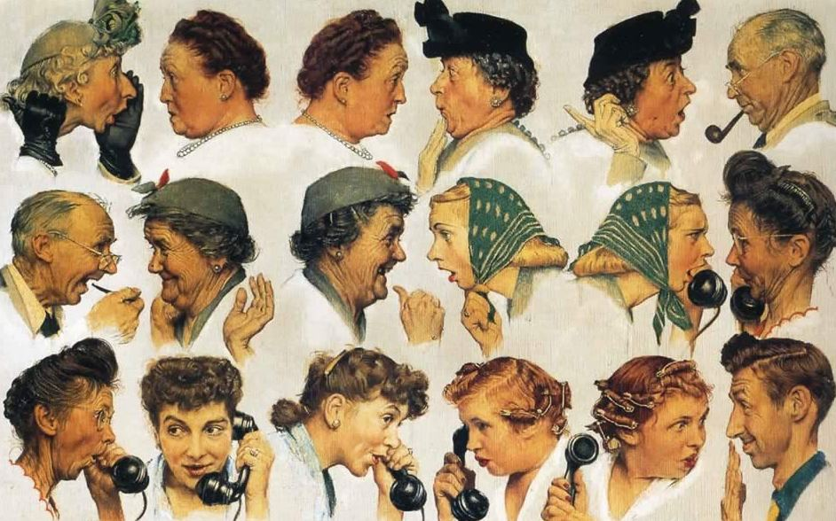

Slide 18
Summary So Far
Many early copies give us confidence that our New Testament is an accurate copy of the original documents.

Slide 19
Did the original documents tell the truth?
Early writings, too early to contain legend.
Challenges to audiences.
Eyewitness testimony, and claims of honesty.
Demonstrated accuracy and honesty.
Supporting evidence outside the Bible.

Slide 20
Early Writings, Too Early to Contain Legend
Acts AD 62
Luke Before AD 60
Mark AD 50-60
Paul’s letters: AD 50-66
Matthew AD 70-80
John AD 80-100
Much of the NT: 30-40 years after the events

Slide 21
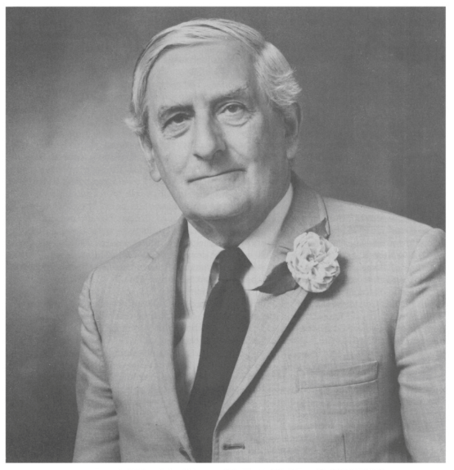
“Herodotus enables us to test the tempo of myth-making, and the tests suggest that even two generations are too short a span to allow the mythical tendency to prevail over the hard historic core of the oral tradition.”
A. N. Sherwin-White
Historian of Ancient Rome
Roman Society and Roman Law in the New Testament, 190.

Slide 22
Challenges to Audiences
“He was buried and he was raised from the dead on the third day, just as the scriptures said. He was seen by Peter and then by the twelve. After that, he was seen by more than 500 of his followers at one time, most of whom are still alive, though some have died...” (1 Corinthians 15:4-8)

Slide 23
Challenges to Audiences
“Suddenly Festus shouted, ‘Paul, you are insane. Too much study has made you crazy!’ But Paul replied, ‘I am not insane, Most Excellent Festus. What I am saying is the sober truth. And King Agrippa knows about these things. I speak boldly, for I am sure these events are all familiar to him for they were not done in a corner!’” (Acts 26:24-26)

Slide 24
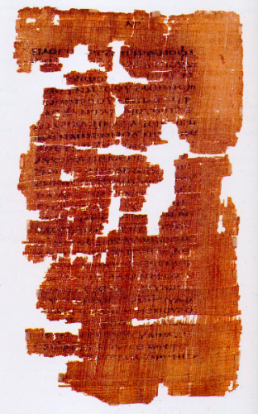
What about the “Lost” Gnostic Gospels?
Approx. 50 writings dated 2nd-4th century
Gospel of Mary
Gospel of Thomas
Gospel of Philip
Gospel of Judas
Gospel of Truth
Apocryphon of James
Apocryphon of John
Hypostasis of the Archons
Infancy Gospel of Thomas
The Second Treatise of the Great Seth
Gospel of Judas
ca. AD 280

Slide 25
Eyewitness Testimony, Claims of Honesty
“Many people have set out to write accounts about the events that have been fulfilled among us. They used the eyewitness reports circulating among us from the early disciples. Having carefully investigated everything from the beginning, I also have decided to write an accurate account for you, most honorable Theophilus, so you can be certain of the truth of everything you were taught.” (Luke 1: 1-4)

Slide 26
Eyewitness Testimony, Claims of Honesty
“We were not making up clever stories when we told you about the powerful coming of our Lord Jesus Christ. We saw his majestic splendor with our own eyes.” (2 Peter 1:16)
“We proclaim to you what we ourselves have actually seen and heard so that you may have fellowship with us....” (1 John 1:3)

Slide 27
Demonstrated Accuracy and Honesty
“It was now the fifteenth year of the reign of Tiberius, the Roman emperor. Pontius Pilate was governor over Judea; Herod Antipas was ruler over Galilee; his brother Philip was ruler over Iturea and Traconitis; Lysanias was ruler over Abilene. Annas and Caiaphas were the high priests…” (Luke 3:1-2)

Slide 28
Demonstrated Accuracy and Honesty
Luke names thirty two countries, fifty-four cities and nine islands without a single mistake.
The New Testament writers name over 30 people, such as:
Tiberius Caesar, Pilate, Herod the Great, Herod Antipas, Caesar Augustus, Caiaphas, Agrippa I and II, etc.

Slide 29
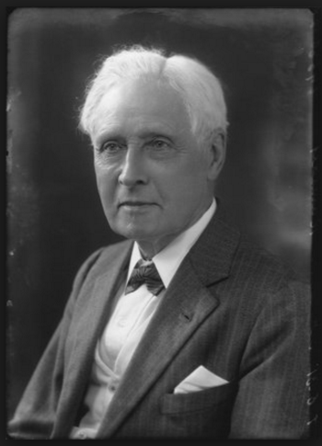
“Luke is an historian of the first rank; not merely are his statements of fact trustworthy… this author should be placed along with the very greatest of historians… Luke’s history is unsurpassed in respect of its trustworthiness.”
Sir William Ramsay
1851-1939
Archaeologist and New Testament Scholar

Slide 30
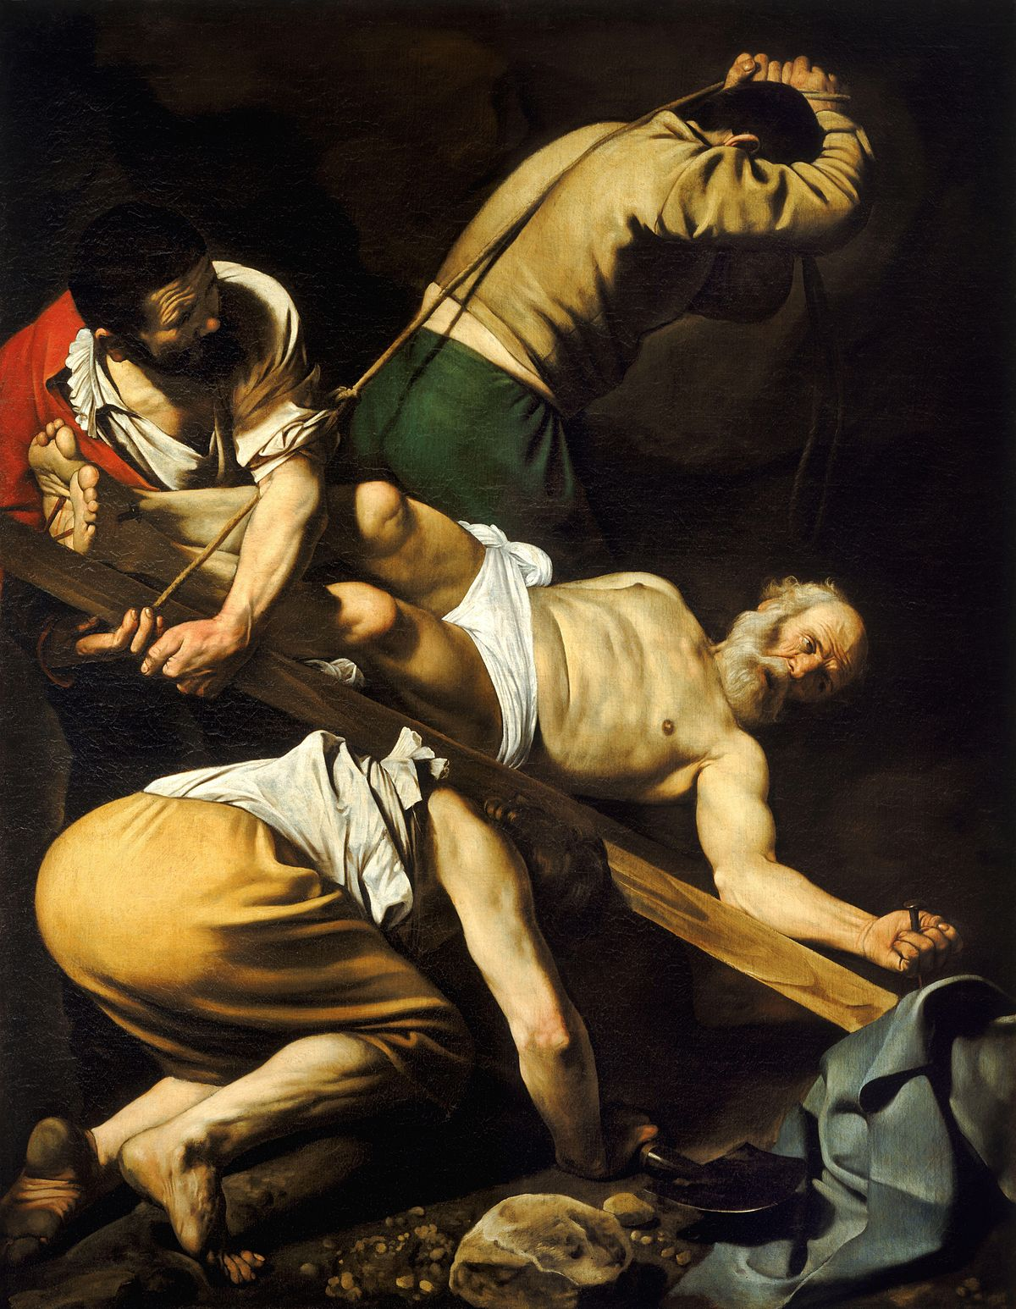
Demonstrated Honesty
Peter: Crucified upside down.
Andrew, Peter’s brother: Crucified.
Phillip: Crucified in Hieropolis.
Bartholomew: Flayed with knives in Armenia.
James, John’s brother: Killed by the sword.
Matthew: Killed by the sword in Ethiopia.
Mathias: Stoned to death.

Slide 31
Demonstrated Honesty
Thomas: Speared to death in India.
John: Died after exile on Patmos.
Luke: Hanged.
James, brother of Jesus: Stoned to death.
Mark: Dragged by horse.
Jude: Killed by arrows.
Paul: Beheaded by Nero in Rome.

Slide 32
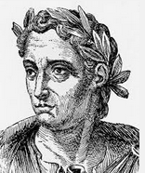
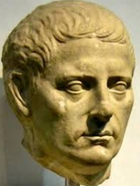
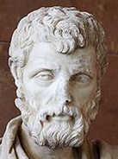
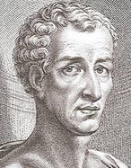
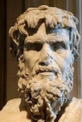
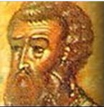
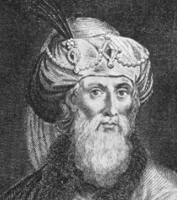
Supporting Evidence Outside the Bible
10 Non-Christian Writers
Josephus – Jewish historian
Tacitus – Roman Historian
Pliny the Younger – Roman Politician
Phlegon – Freed slave who wrote history
Thallus – First century historian
Seutonius – Roman historian
Lucian – Greek satirist
Celsus – Roman philosopher
Mara Bar-Serapion – Private citizen writing to his son
Talmud – Jewish scripture

Slide 33
Jesus lived during the time of Tiberius Caesar.
He lived a virtuous life.
He was a wonder-worker.
He had a brother named James.
He was acclaimed to be the Messiah.
He was crucified under Pontius Pilate.
He was crucified on the eve of the Jewish Passover.
Darkness and an earthquake occurred when he died.
His disciples believed he rose from the dead.
His disciples were willing to die for their belief.
Christianity spread rapidly as far as Rome.
His disciples denied the Roman gods and worshiped Jesus as God.

Slide 34
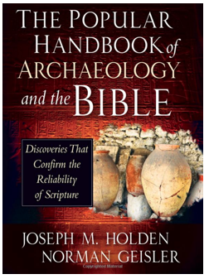
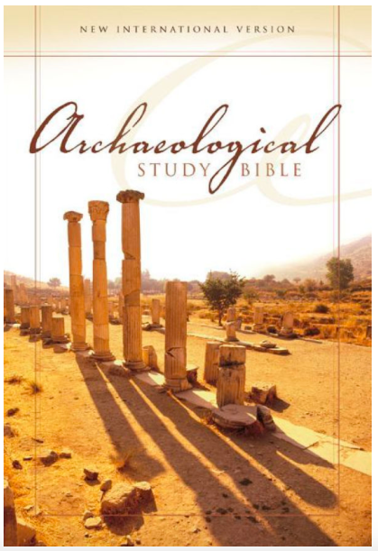
Supporting Evidence Outside the Bible
Archaeology

Slide 35
“In extraordinary ways, modern archaeology has affirmed the historical core of the Old and New Testaments, corroborating key portions of the stories of Israel’s patriarchs, the Exodus, the Davidic monarchy, and the life and times of Jesus.”
Jeffery Sheler, “Is the Bible True?”
US News & World Report, October 25, 1999, 52.

Slide 36
Summary So Far
Many early copies give us confidence that our New Testament is an accurate copy of the original documents.
Early testimony with demonstrated accuracy and honesty, supported by external sources, provides confidence the accounts are historically true.

Slide 37
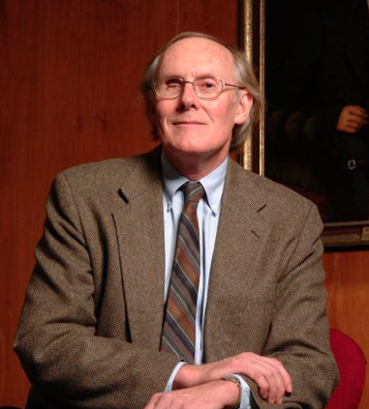
“ There exists no document from the ancient world witnessed by so excellent a set of textual and historical testimonies.... An honest [person] cannot dismiss a source of this kind. Skepticism regarding the historical credentials of Christianity is based on an irrational [anti-supernatural] bias.”
Clark H. Pinnock
1937-2010
Professor, Systematic Theology
McMaster Divinity College

Slide 38
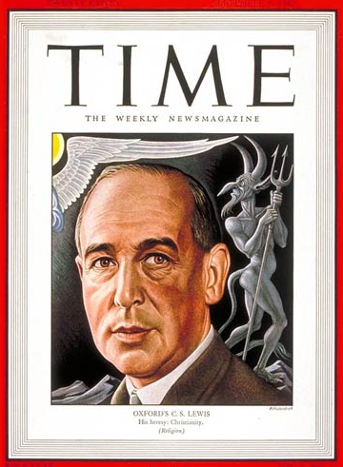
“But if we admit God, must we admit miracles? Indeed, indeed, you have no security against it. That is the bargain.”
C. S. Lewis
Miracles

Slide 39
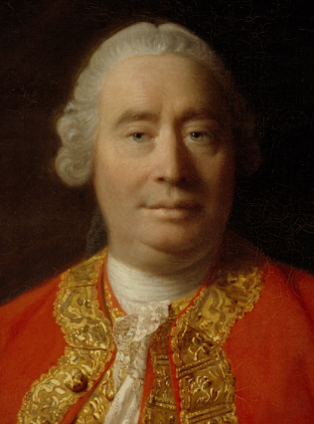
“The overwhelming majority of people in human history have never witnessed a miracle. This amounts to proof that miracles don’t happen.”
David Hume
1711-1776
Scottish Naturalist
Philosopher

Slide 40
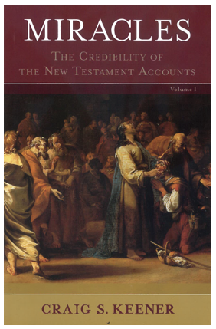
Hume was Wrong
“Hundreds of millions of people alive today claim that they have witnessed or experienced miraculous healings.”
Craig Keener
New Testament Scholar

Slide 41
“The assumption that supra-human activity is impossible is an interpretive grid, not a demonstrated fact.”
“Supernatural explanations should be welcome on the scholarly table along with other explanations.”
Craig Keener
New Testament Scholar

Slide 44
Faith
On Solid Ground
https://gregenos.org/hillside/
7/07/24 The Nature of Truth: What is Truth?
7/14/24 The Evidence for the Existence of God
7/21/24 The Historical Reliability of the New Testament
7/28/24 The Evidence for the Resurrection
8/04/24 How Do We Know the Bible is God’s Word?
8/11/24 Why God Allows Evil

