Slide 2
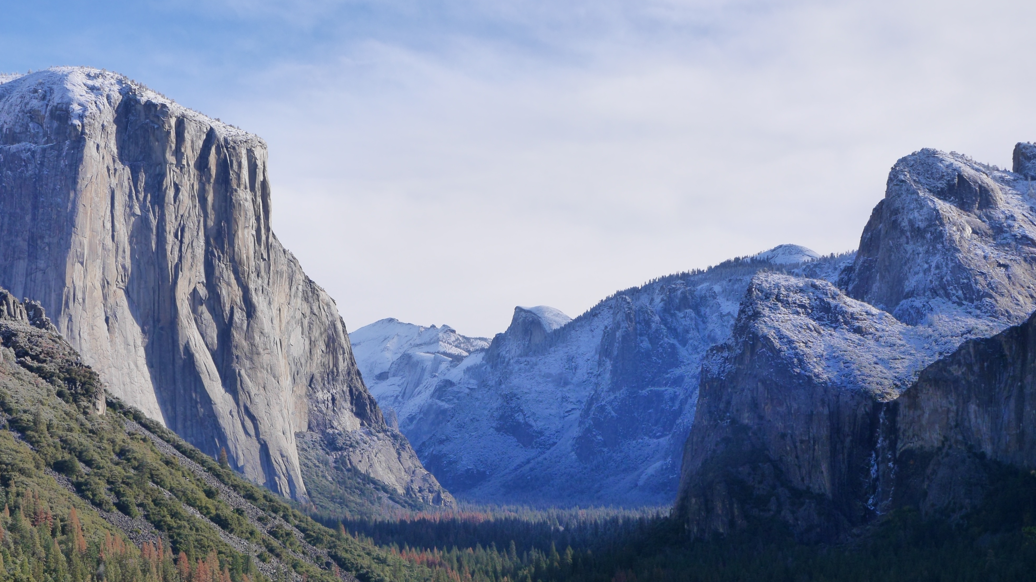
Faith
On Solid Ground
How We Know That Christianity Is True

Slide 3
Faith
On Solid Ground
https://gregenos.org/hillside/
7/07/24 The Nature of Truth: What is Truth?
7/14/24 The Evidence for the Existence of God
7/21/24 The Historical Reliability of the New Testament
7/28/24 The Evidence for the Resurrection
8/04/24 How Do We Know the Bible is God’s Word?
8/11/24 Why God Allows Evil

Slide 4
The Nature of Truth: What is Truth?

Slide 5
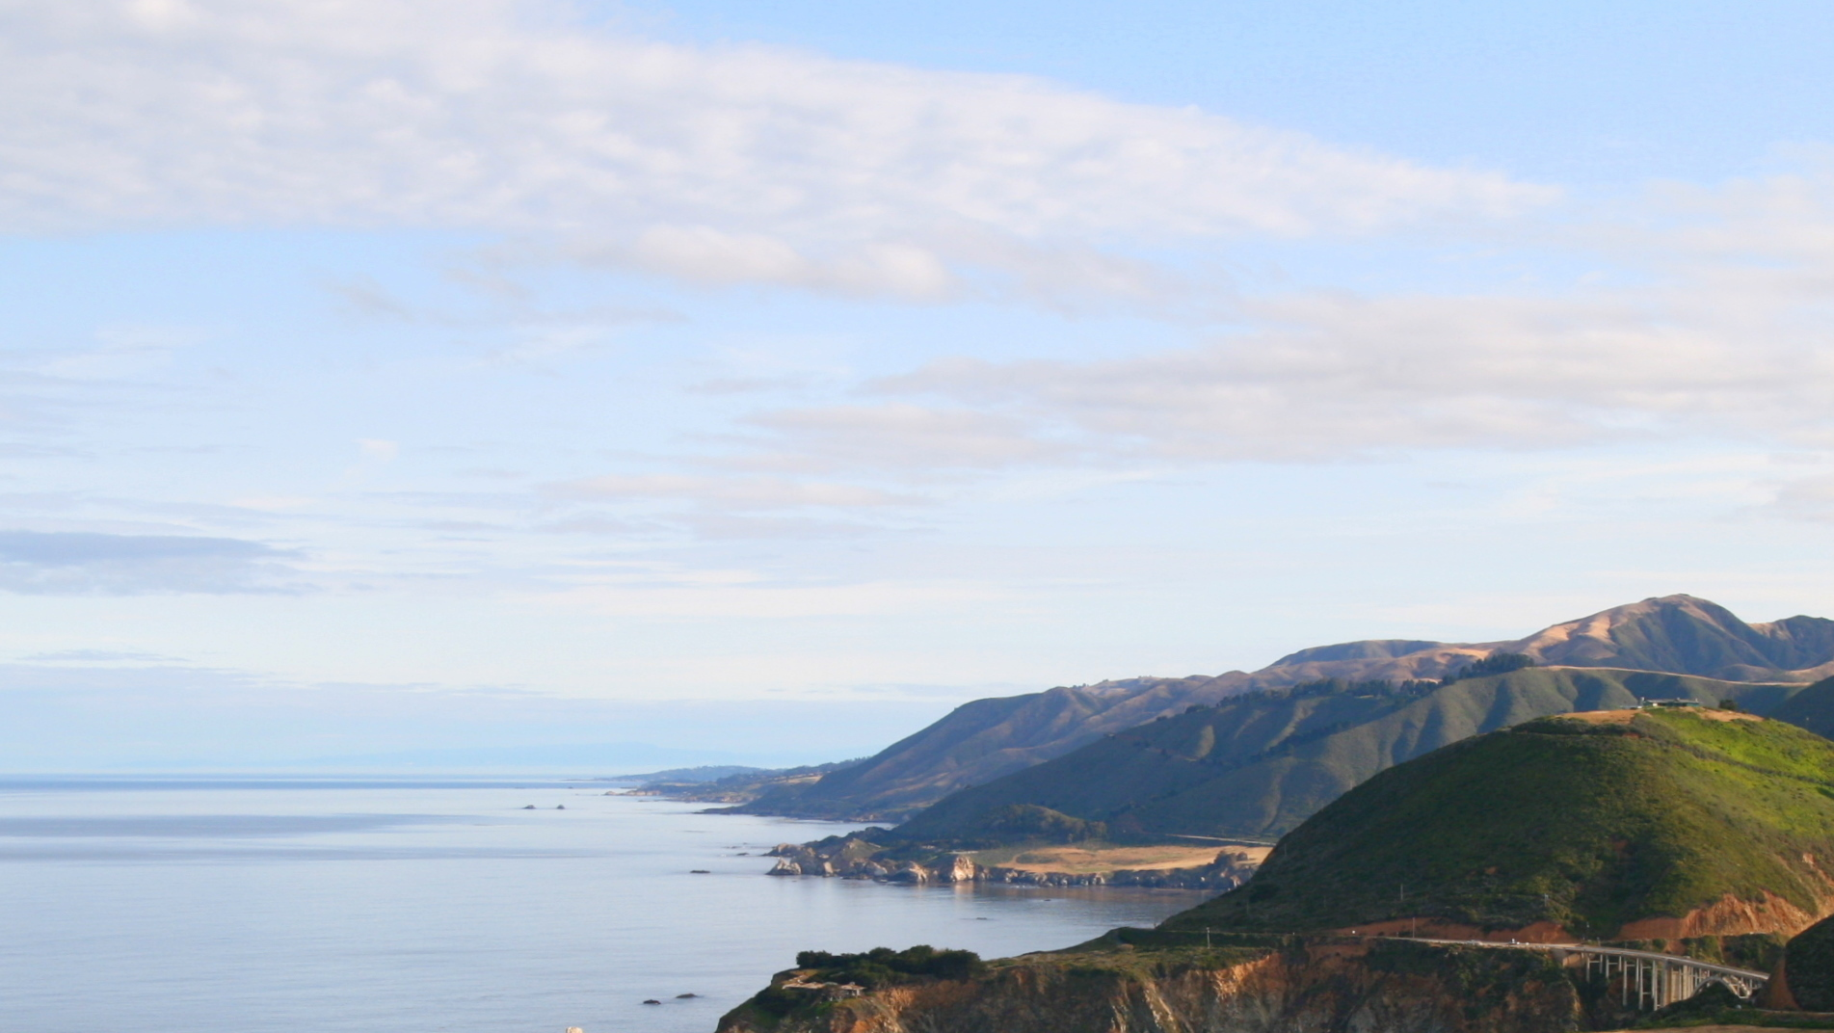
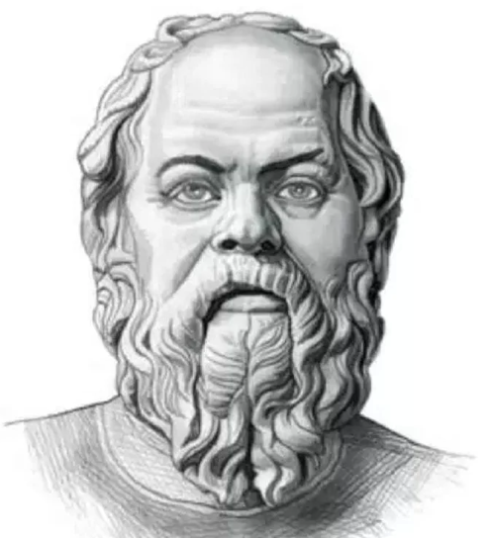
“The unexamined life is not worth living.”
Maximum Sky
The unexamined faith is not worth living.
Socrates
ca. 399 BC

Slide 6
Worldview Questions
Origin. Where did I come from? Do I matter?
Meaning. Why am I here? What is my purpose in life?
Morality. What is right and wrong? How should I live?
Destiny. What happens when I die? Is this life all there is?
Worldview = Faith

Slide 7
Worldviews
Christianity
Hinduism
Sikhism
Islam
Buddhism
Taoism
Judaism
Confucianism
Secular Atheist

Slide 8
A Call to Reason
“Come now, and let us reason together, says the Lord…” (Isaiah 1:18)

Slide 9
Be Prepared to Give Answers
“Always be prepared to give an answer to everyone who asks you to give the reason for the hope that you have. But do this with gentleness and respect…” (1 Peter 3:15)
reason, Apologia: Apologetics

Slide 10
Be Prepared to Give Answers
“Let your conversation be always full of grace, seasoned with salt, so that you may know how to answer anyone.” (Colossians 4:6)

Slide 11
What is Truth?
Truth corresponds to reality.
Truth is simply telling it like it is.
The correspondence view of Truth

Slide 12
What is Truth?
Can we even know the truth?
Does truth depend on perspective?
Can all religions be true?
Are all religions on paths to the same God or ultimate truth?

Slide 13
Questions About Truth
Can we even know the truth?
“There is no truth.”
“You can’t know the truth.”

Slide 14
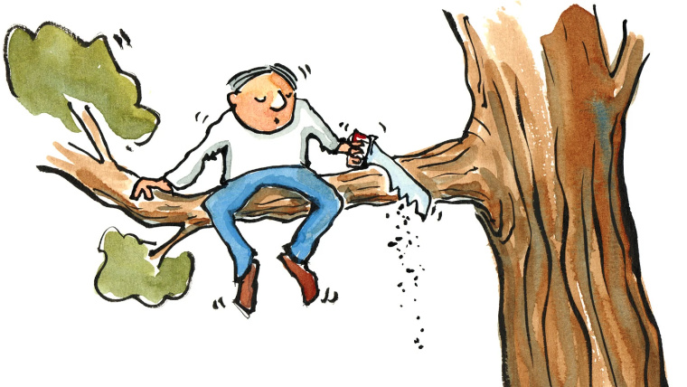
Self-Defeating Statements
“Don’t believe anything you read.”
I guess I shouldn’t believe this.

Slide 15
Self-Defeating Statements
Maximum Sky
“You should not judge.”
Whoever wrote this is judging me.

Slide 16
Self-Defeating Statements
Maximum Sky
“You should not force your morals on others.”
Are you forcing this morality on me?

Slide 17
Self-Defeating Statements
Maximum Sky
“There is no truth.”
Is that true?

Slide 18
Self-Defeating Statements
Maximum Sky
“Truth can not be known.”
Is this true? If so, how can I know?

Slide 19
Self-Defeating Statements
Maximum Sky
“You should doubt everything.”
Should I doubt that?

Slide 20
Self-Defeating Statements
Maximum Sky
“You can’t know anything for sure.”
Then I suppose I can’t know that for sure.

Slide 21
Self-Defeating Statements
Maximum Sky
“You can’t know for sure what happened in the past.”
Why not?

Slide 22
What We Know About Truth
1. There is truth; truth can be known; we don’t have to doubt everything; and we can know some things for sure; even things in the past.

Slide 23
Questions About Truth
Can we even know the truth?
”There is no truth.”
“You can’t know the truth.”
Does truth depend on perspective?

Slide 24
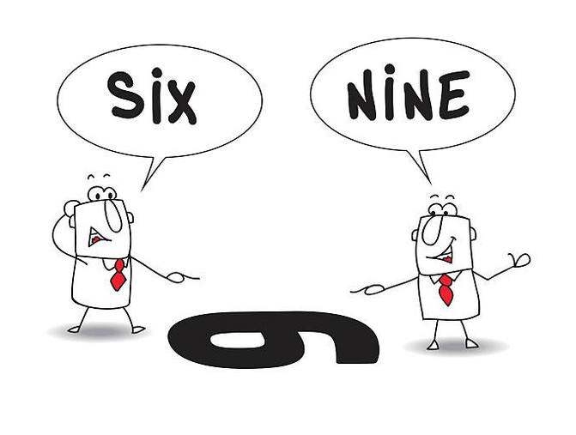
Does Truth Depend on Perspective?
Alfred
Mateo

Slide 25
What We Know About Truth
1. There is truth; truth can be known; we don’t have to doubt everything; and we can know some things for sure; even things in the past.
2. Perspectives, experience and opinions are relative and can vary, but truth is absolute, and is the same for everyone everywhere, and for all time.
Notes:
..

Slide 27
Questions About Truth
Can we even know the truth?
”There is no truth.”
“You can’t know the truth.”
Does truth depend on perspective?
Can all religions be true?

Slide 28
The Law of Non-Contradiction
“A” can not be both “A” and “non-A” at the same time and in the same sense.
Opposites can not both be true.

Slide 29
Are All Religions or Worldviews True?
Opposites can not both be true
There is a God or there is not a God
God is a trinity or God is not a trinity
Jesus is God or Jesus is not God
Works needed or works are not needed
All will be saved or all will not be saved

Slide 30
Opposing Views
Maximum Sky
“All views are true, even opposite views.”
Is the opposite of that true?

Slide 31
Questions About Truth
Can we even know the truth?
”There is no truth.”
“You can’t know the truth.”
Does truth depend on perspective?
Can all religions be true?
Are all religions on paths to the same God or ultimate truth?

Slide 32
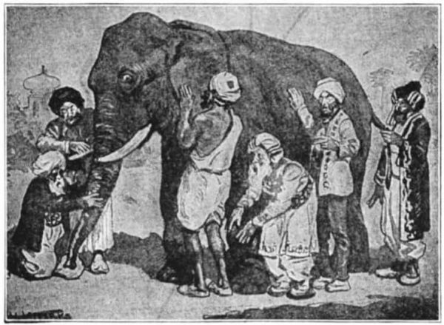
Are all religions on paths to the same God or ultimate truth?
Maximum Sky

Slide 33
What We Know About Truth
1. There is truth; truth can be known; we don’t have to doubt everything; and we can know some things for sure; even things in the past.
2. Perspectives, experience and opinions are relative and vary, but truth is absolute, and is the same for everyone everywhere, and for all time.
3. All religions can not be true, because opposing truth claims can not be true.
4. How do we know which worldview is true?
Examine the Evidence!

Slide 34
Faith
On Solid Ground
https://gregenos.org/hillside/
7/07/24 The Nature of Truth: What is Truth?
7/14/24 The Evidence for the Existence of God
7/21/24 The Historical Reliability of the New Testament
7/28/24 The Evidence for the Resurrection
8/04/24 How Do We Know the Bible is God’s Word?
8/11/24 Why God Allows Evil

