Slide 2
Faith
On Solid Ground
How We Know That Christianity Is True

Slide 4
Faith
On Solid Ground
https://gregenos.org/hillside/
Christianity is a trust that God will do what He said He would do, based on good evidence that the entire story is true.

Slide 5
Faith
On Solid Ground
https://gregenos.org/hillside/
7/07/24 The Nature of Truth: What is Truth?
7/14/24 The Evidence for the Existence of God
7/21/24 The Historical Reliability of the New Testament
7/28/24 The Evidence for the Resurrection
8/04/24 How Do We Know the Bible is God’s Word?
8/11/24 Why God Allows Evil

Slide 6
How Do We Know the Bible is God’s Word?

Slide 7
How Do We Know the Bible is God’s Word?
The unity of the Bible.
Old Testament prophecy concerning the coming of Jesus.
The teaching and authority of Jesus.
What would it mean?

Slide 8
The Unity of the Bible
66 Books
40 Writers
1500 Years
3 Languages
1 Theme
The redemption of mankind through Jesus Christ

Slide 9
How Do We Know the Bible is God’s Word?
The unity of the Bible.
Old Testament prophecy concerning the coming of Jesus.
The teaching and authority of Jesus.
What would it mean?

Slide 10
Old Testament Prophecy Fulfilled in the First Coming of Jesus
Human Race (Gen. 3:15)
Ethnic Group (Gen. 12:3)
Tribe of Judah (Gen. 49:10)
Dynasty of David (2 Sam. 7:12)
How: of a virgin (Isaiah 7:14)
Where: Bethlehem (Micah 5:2)
When: 33 A.D. (Daniel 9:24)
Crucifixion of Jesus
There are some 100 predictions in the Bible about Jesus’ first coming that were fulfilled.
-- Barton Payne, Encyclopedia of Biblical Prophesy

Slide 11
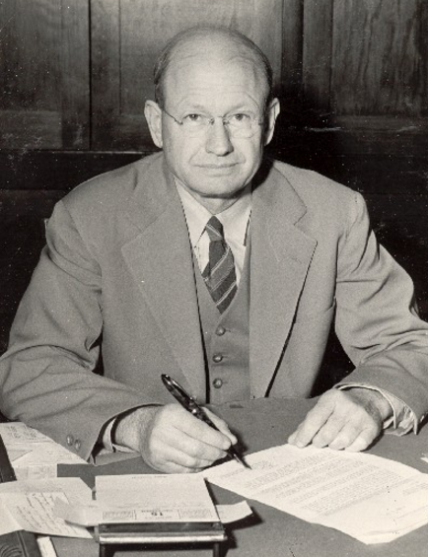
Old Testament Prophecy of Jesus
Chances of just 8 of them to come true?
1 in 1x10¹⁷
Peter Stoner, mathematician
Co-Founder, American Scientific Affiliation
Author, Science Speaks (Pg. 100-107)

Slide 12
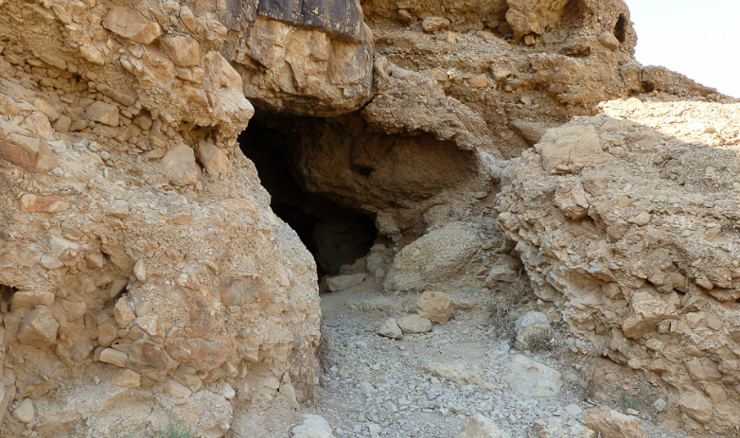
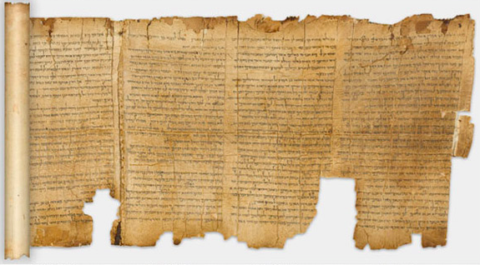
Maximum Sky
Dead Sea Scrolls, caves of Qumran, discovered 1949.
Great Isaiah scroll: ca. 125 BC. (Isaiah written ca. 700 BC).

Slide 13
How Do We Know the Bible is God’s Word?
The unity of the Bible.
Old Testament prophecy concerning the coming of Jesus.
The teaching and authority of Jesus.
What would it mean?

Slide 14
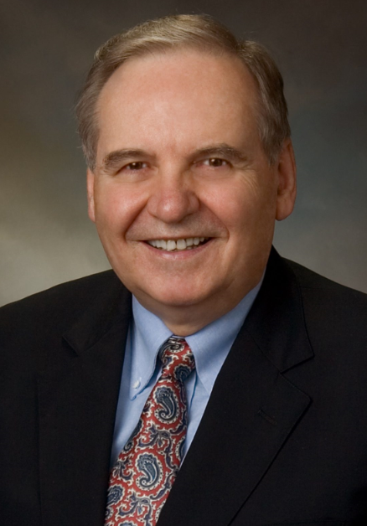
An Argument Based on the Authority of Jesus
The New Testament is historically reliable.
In the New Testament, Jesus claimed to be God and predicted his Resurrection.
The Resurrection confirmed Jesus’ claim to be God, therefore, Jesus is God.
Whatever Jesus (who is God) taught is true.
Jesus taught that the Bible is the Word of God. He affirmed the Old Testament and promised the coming of the New Testament by the Holy Spirit.
Dr. Norman Geisler, author
Twelve Points That Show Christianity is True
The Bible is from God, and true. Anything opposed to it is false.
Inductive Reasoning: Collecting evidence and following the evidence wherever it leads.

Slide 15
Seven Ways Jesus Claimed To Be God
Jesus claimed to:
Be the great “I AM” (John 8:58).
Share God’s glory (John 17:5).
Be equal with God (John 10:30).
Be the Messiah-God (John 4:25-26, Mark 14:61-62).
Be worthy of honor like God (John 5:23).
Be equal in authority with God (Matt. 28:18).
Be able to answer prayer in His name (John 14:13).

Slide 16
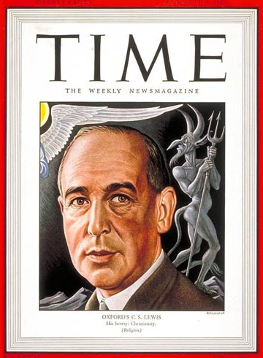
Just a Great Moral Teacher?
“I am trying here to prevent anyone saying the really foolish things that people often say about Him: ‘I’m ready to accept Jesus as a great moral teacher, but I don’t accept His claim to be God.’ That is the one thing we must not say. A man who was merely a man and said the sort of things Jesus said would not be a great moral teacher. He would rather be a lunatic, on the level with the man who says he is a poached egg, or else he would be the Devil of Hell.”
C. S. Lewis
Mere Christianity
The Trilemma: Liar, Lunatic, or Lord?

Slide 17
Jesus Predicted His Resurrection
“The Son of Man is going to be betrayed into the hands of men. They will kill Him, and on the third day He will be raised to life.” Matt. 17:22-23
“Then Jesus began to tell them that the Son of Man must suffer many terrible things and be rejected by the elders, the leading priests, and the teachers of religious law. He would be killed, but three days later he would rise from the dead.” Mark 8:31
(See also Matt. 12:40, John 2:19-21)

Slide 18
The Resurrection Confirms Jesus’ Claims
“People of Israel listen! God publicly endorsed Jesus the Nazarene by doing powerful miracles, wonders, and signs through him, as you well know.” Acts 2:22

Slide 19
Whatever Jesus Taught or Affirmed Is True
Jesus is God, and a theistic God is:
All-knowing and can not make mistakes.
Morally perfect and can not deceive. (Titus 1:2, Heb. 6:18)
Therefore, whatever Jesus taught is true.

Slide 20
An Argument Based on the Authority of Jesus
The New Testament is historically reliable.
In the New Testament, Jesus claimed to be God and predicted his Resurrection.
The Resurrection confirmed Jesus’ claim to be God, therefore, Jesus is God.
Whatever Jesus (who is God) taught is true.
Jesus taught that the Bible is the Word of God. He affirmed the Old Testament and promised the coming of the New Testament by the Holy Spirit.
Dr. Norman Geisler, author
Twelve Points That Show Christianity is True
The Bible is from God, and true. Anything opposed to it is false.
Inductive Reasoning: Collecting evidence and following the evidence wherever it leads.

Slide 21
Jesus and the Old Testament
Divinely Authoritative. (Matt. 4:4, 4:7, 4:10).
Imperishable (Matt. 5:17-18).
Infallible (John 10:35).
Inerrant or without error (Matt. 22:29).
Historically reliable (Matt. 12:40, 24:37-38).
Scientifically accurate (Matt. 19:4-5).

Slide 22
“My high school science teacher once told me that much of Genesis is false. But since my high school science teacher did not prove he was God by rising from the dead, I’m going to believe Jesus instead.” -- Andy Stanley

Slide 23
Jesus and the Old Testament
Divinely Authoritative. (Matt. 4:4, 4:7, 4:10).
Imperishable (Matt. 5:17-18).
Infallible (John 10:35).
Inerrant or without error (Matt. 22:29).
Historically reliable (Matt. 12:40, 24:37-38).
Scientifically accurate (Matt. 19:4-5).
Ultimate, supreme (Matt. 15:3-6).

Slide 24
Jesus Promised the New Testament
Jesus promised the Holy Spirit would teach them “all things” and lead them into “all truth.”
“But the Advocate, the Holy Spirit, whom the Father will send in my name, will teach you all things and will remind you of everything I have said to you.” (John 14:26)
“But when he, the Spirit of truth, comes, he will guide you into all truth. He will not speak on his own; he will speak only what he hears, and he will tell you what is yet to come.” (John 16:13).

Slide 25
The Doctrine of Inspiration
“All scripture is God-breathed and is useful for teaching, rebuking, correcting and training in righteousness.”
2 Timothy 3:16 (NIV)

Slide 26
The Doctrine of Inerrancy
“When all the facts become known, they will demonstrate that the Bible in its original autographs and correctly interpreted is entirely true and never false…” -- Evangelical Dictionary of Theology
God can not make a mistake.

Slide 27
An Argument Based on the Authority of Jesus
The New Testament is historically reliable.
In the New Testament, Jesus claimed to be God and predicted his Resurrection.
The Resurrection confirmed Jesus’ claim to be God, therefore, Jesus is God.
Whatever Jesus (who is God) taught is true.
Jesus taught that the Bible is the Word of God. He affirmed the Old Testament and promised the coming of the New Testament by the Holy Spirit.
Dr. Norman Geisler, author
Twelve Points That Show Christianity is True
The Bible is from God, and true. Anything opposed to it is false.
Inductive Reasoning: Collecting evidence and following the evidence wherever it leads.

Slide 28
What does this mean?

Slide 29
Thomas Cole

Slide 31
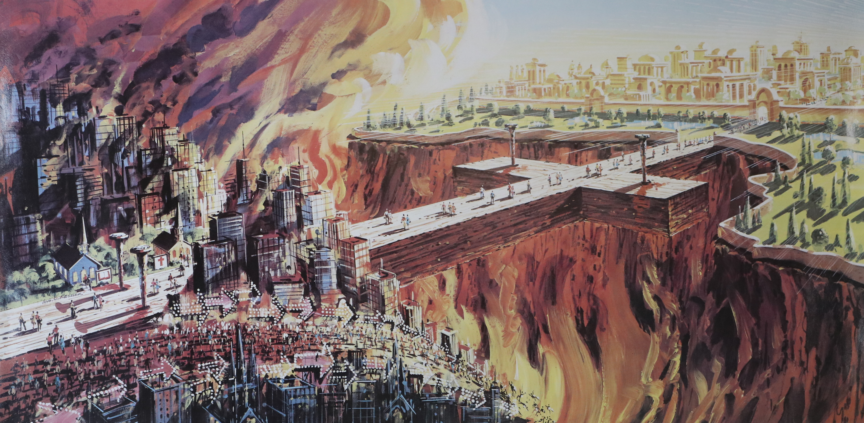
“The Bridge” by William C. Ressler

Slide 32
Faith
On Solid Ground
https://gregenos.org/hillside/
7/07/24 The Nature of Truth: What is Truth?
7/14/24 The Evidence for the Existence of God
7/21/24 The Historical Reliability of the New Testament
7/28/24 The Evidence for the Resurrection
8/04/24 How Do We Know the Bible is God’s Word?
8/11/24 Why God Allows Evil

