Slide 2
Faith
On Solid Ground
How We Know That Christianity Is True
https://gregenos.org/hillside/

Slide 3
Faith
On Solid Ground
https://gregenos.org/hillside/
Christianity is a trust that God will do what He said He would do, based on good evidence that the entire story is true.

Slide 4
Faith
On Solid Ground
https://gregenos.org/hillside/
7/07/24 The Nature of Truth: What is Truth?
7/14/24 The Evidence for the Existence of God
7/21/24 The Historical Reliability of the New Testament
7/28/24 The Evidence for the Resurrection
8/04/24 How Do We Know the Bible is God’s Word?
8/11/24 Why God Allows Evil

Slide 5
The Existence of God

Slide 6
Theism: Belief in one infinite, eternal, personal God who created the universe and is active in every day affairs.

Slide 7
How do we know a Theistic God exists?
The universe had a beginning.
The universe and life display complex design.
An objective moral law exists.

Slide 8
How do we know a Theistic God exists?
Maximum Sky
The Cosmological Argument.
The Teleological (or Design) Argument.
The Moral Argument.

Slide 9
The Cosmological Argument
Everything that had a beginning had a cause.
The universe had a beginning.
Therefore, the universe had a cause.

Slide 10
The Cosmological Argument
Why is there Something rather than Nothing?

Slide 11
The Law of Cause and Effect
“Every material effect (anything that has a beginning) must have an adequate antecedent or simultaneous cause.”

Slide 12
For every Effect there must be a Cause
Maximum Sky

Slide 13
The Cosmological Argument
Everything that had a beginning had a cause.
The universe had a beginning.
Therefore, the universe had a cause.

Slide 14
The Universe Had a Beginning
Second Law of Thermodynamics:
“In a closed isolated system (like the whole universe) the amount of useable energy is decreasing.”

Slide 15
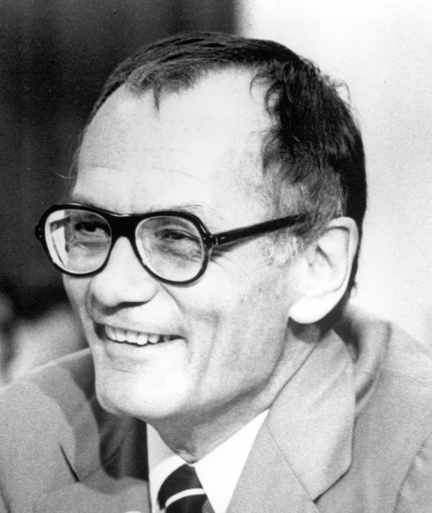
“Once Hydrogen has been burned within a star and converted to heavier elements, it can never be restored to its original state. Minute by minute and year by year, as hydrogen is used up in stars, the supply of this element in the universe grows smaller.”
Dr. Robert Jastrow
1925-2008
Agnostic Astrophysicist,
Founder, NASA Goddard Institute for Space Studies

Slide 16
The Beginning of Time
It is impossible to traverse an infinite series of moments.
But we are here.
The series of moments stretching into the past must have had a beginning.
Time had a beginning.

Slide 17
“That there are, what I or anyone would call supernatural forces at work is now, I think a scientifically proven fact… …The scientist’s pursuit of the past ends in the moment of creation. This is an exceedingly strange development, unexpected by all but theologians. They have always accepted the word of the Bible: ‘In the beginning God created the heavens and the earth.’”
Dr. Robert Jastrow
1925-2008
Agnostic Astrophysicist,
Founder, NASA Goddard Institute for Space Studies

Slide 18
The Cosmological Argument
The cause of the universe must be:
Outside the natural universe, supernatural.
Not finite, without limits, infinite.
Outside of time, eternal, no beginning.
Not physical or material.
Highly powerful.

Slide 19
The Design (Teleological) Argument
Every design had a designer.
The universe has highly complex design.
Therefore, the universe had a designer.

Slide 20
What is Design?
Planning ahead.
A highly improbable state of affairs arranged for a purpose.
Often an assembly of many components which as a whole achieves a greater purpose than any of the individual components by themselves.
Chance is not a good explanation.

Slide 22
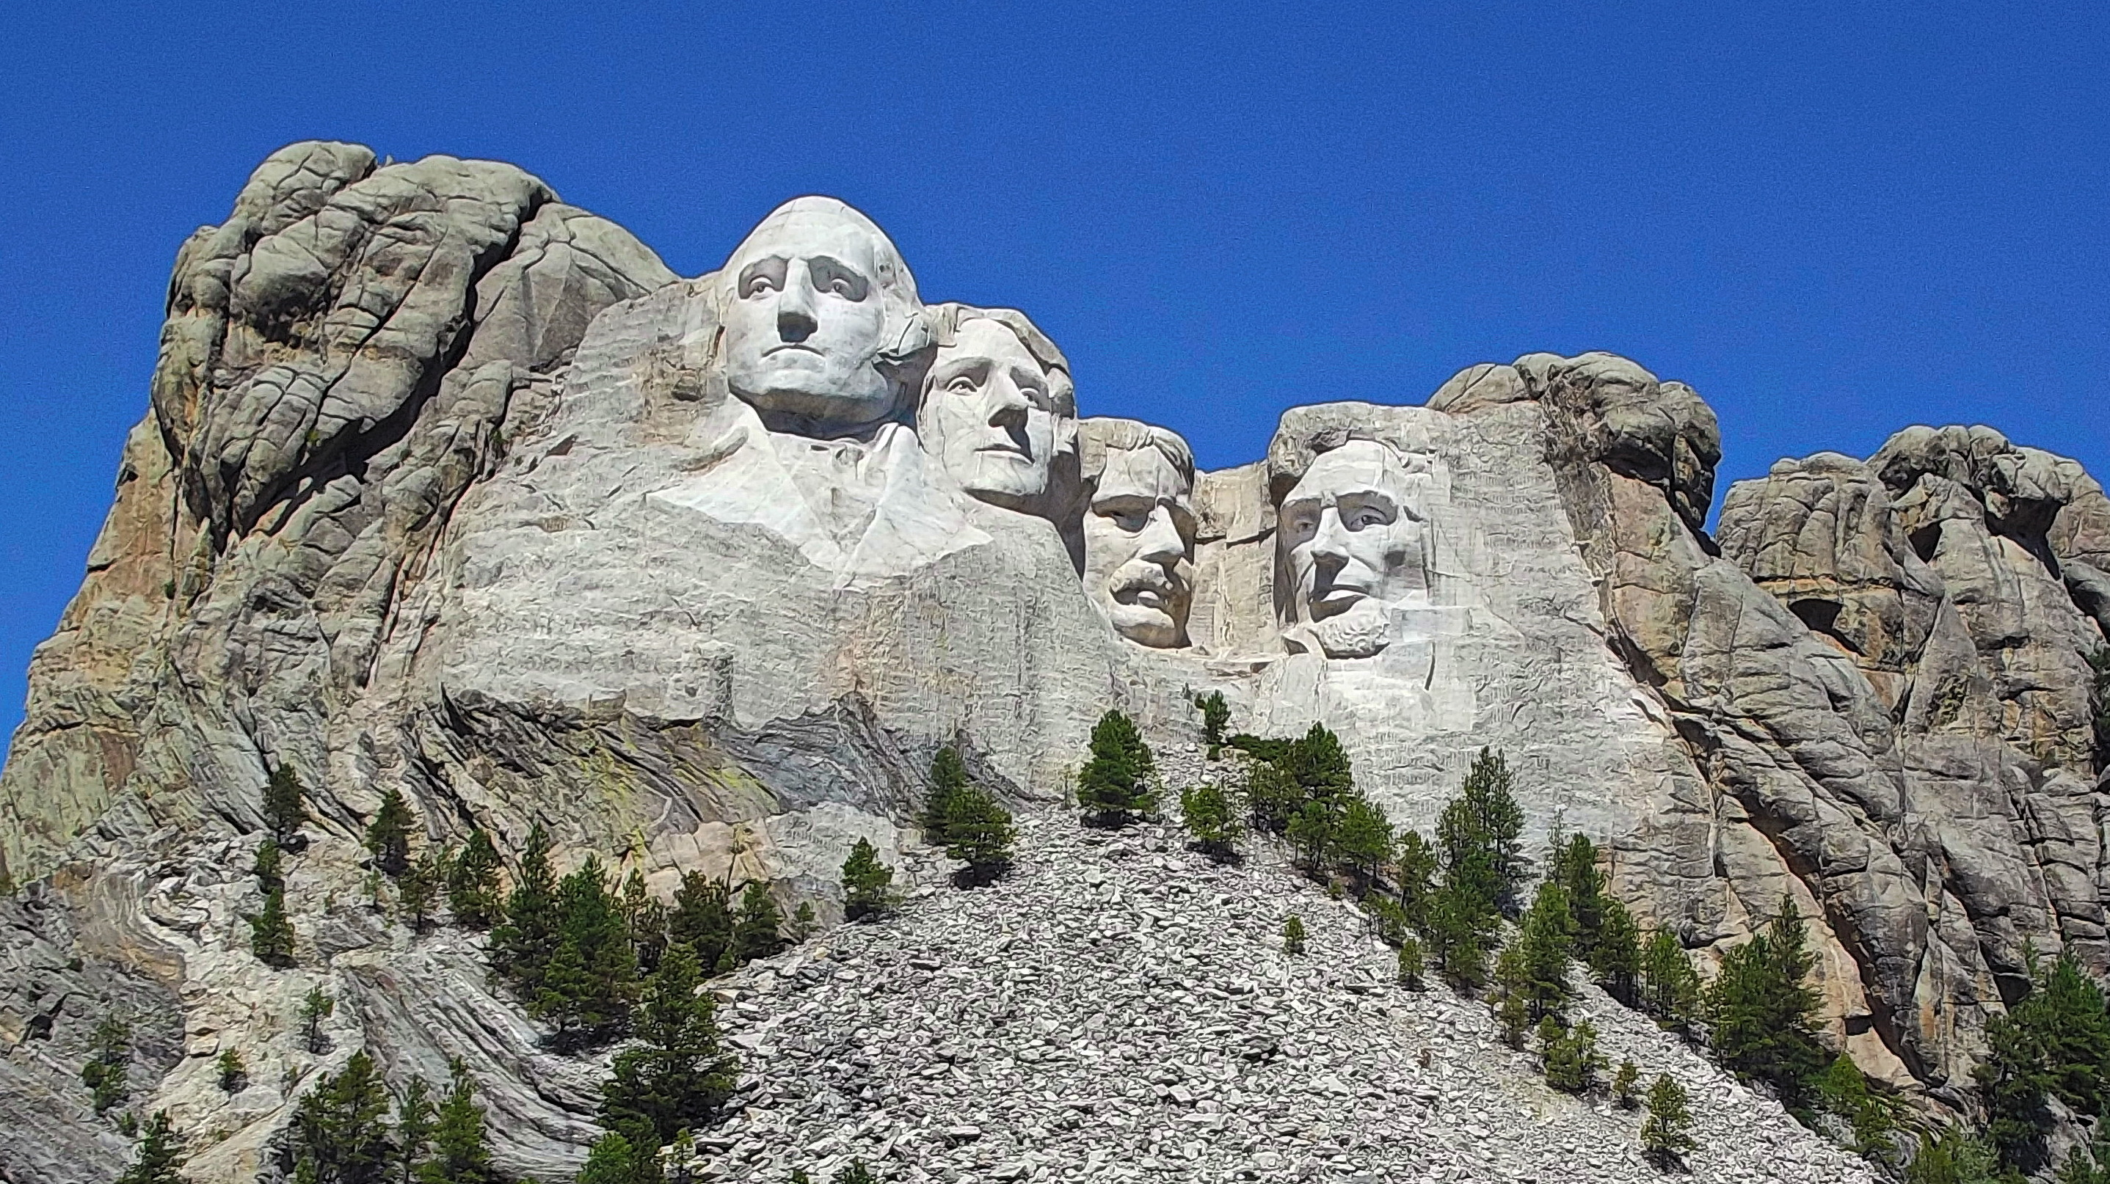

Slide 23
The Anthropic Principle, or Fine Tuning
Oxygen levels
Position of earth to sun
Tilt of the earth
Gravitational force
Strong Nuclear force
Expansion rate of space
Placement of solar system
Electromagnetic force
Position of earth to moon
Jupiter’s protective position

Slide 24
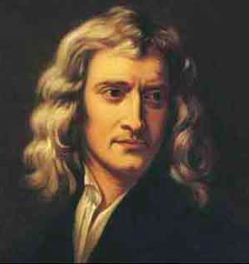
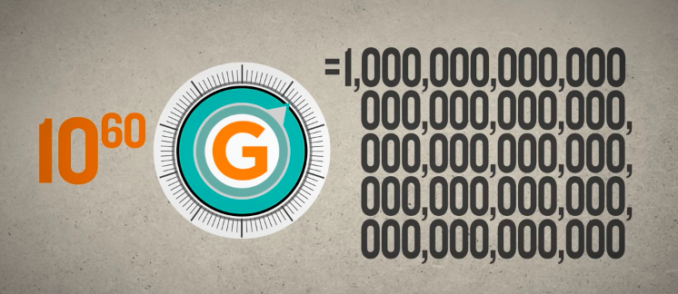
Gravitational Constant
Law of Gravity
F = Gm₁m₂ / r²
Max. Deviation
1 : 10⁶⁰
Sir Isaac Newton

Slide 25
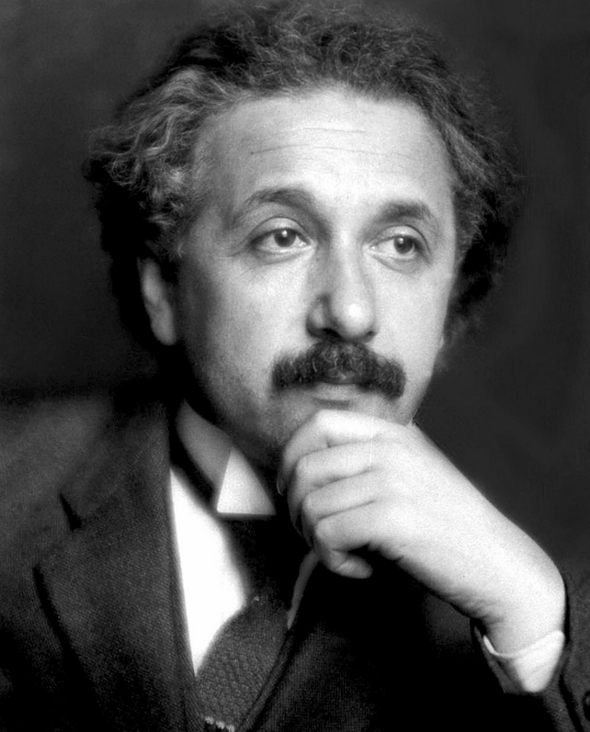
Cosmological Constant
Expansion Rate of Space
Max. Deviation
1 : 10¹²⁰
Albert Einstein

Slide 26
The Anthropic Principle, or Fine Tuning
Oxygen levels
Position of earth to sun
Tilt of the earth
Gravitational force
Strong Nuclear force
Expansion rate of space
Placement of solar system
Electromagnetic force
Position of earth to moon
Jupiter’s protective position
One part in one hundred million trillion trillion trillion trillion trillion trillion.
One atom in entire known universe.

Slide 27
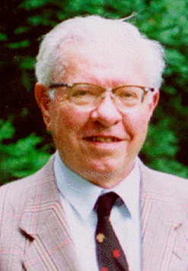
“A common sense interpretation of the facts suggests that a super-intellect has monkeyed with physics, as well as with chemistry and biology, and that there are no blind forces worth speaking about in nature. The numbers one calculates from the facts seem to me so overwhelming as to put this conclusion almost beyond question.”
Sir Fred Hoyle
British Astronomer, atheist

Slide 28
“The anthropic principle is the most interesting next to the proof of the creation, and it is even more interesting because it seems to say that science itself has proven as a hard fact that this universe was made, was designed, for man to live in. It is a very theistic result.”
Dr. Robert Jastrow
Agnostic Astrophysicist (NASA)
God and the Astronomers

Slide 29
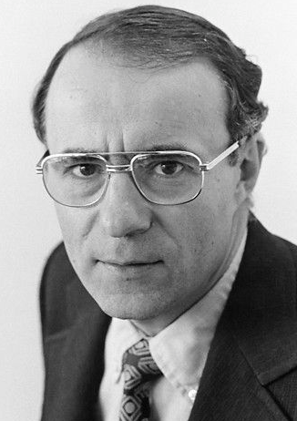
“Astronomy leads us to a unique event, a universe which was created out of nothing and delicately balanced to provide exactly the conditions required to support life. In the absence of an absurdly improbable accident, the observations of modern science seem to suggest an underlying, one might say, supernatural plan.”
Arno Penzias, Physicist
Nobel Laureate
Cosmic Microwave Background

Slide 30
Mechanical Design

Slide 31
“There is no mechanical problem so difficult that it can’t be solved by brute strength and ignorance.”
Uncle Herb Praskey

Slide 33
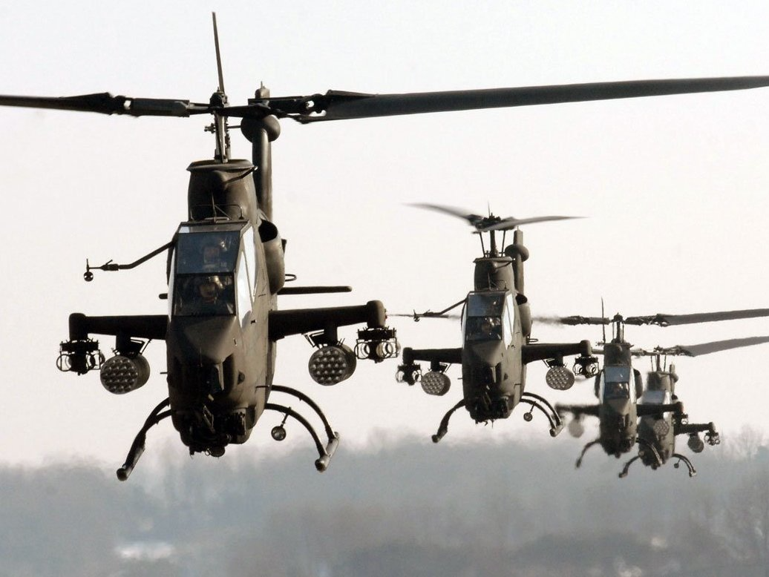

Slide 37
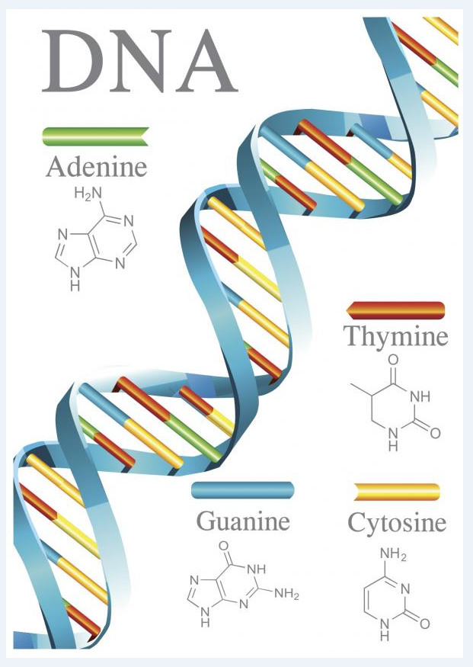
What about DNA?
Human Genome:
3.2 billion base pairs of letters

Slide 38
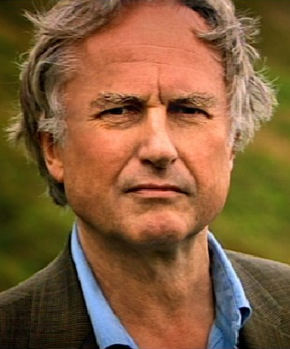
“Some species of the unjustly
called 'primitive' amoebas have as much information in their DNA as
1,000 Encyclopedia Britannicas.”
Where does all the information come from?
Richard Dawkins
Atheist biologist
The Blind Watchmaker,
Pg. 116

Slide 39
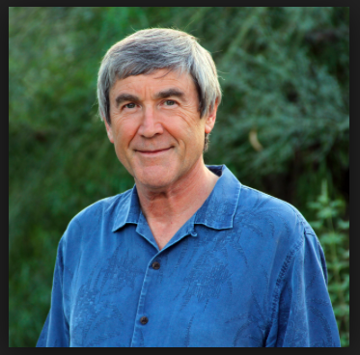
“There is no known law of physics able to create information from nothing.”
“How did stupid atoms spontaneously write their own software? Nobody knows.”
Dr. Paul Davies
Agnostic physicist

Slide 40
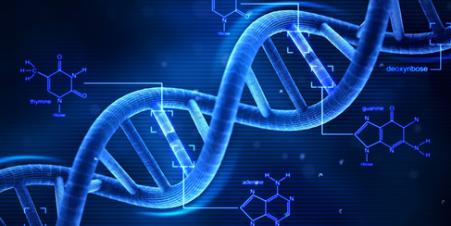
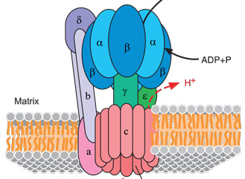
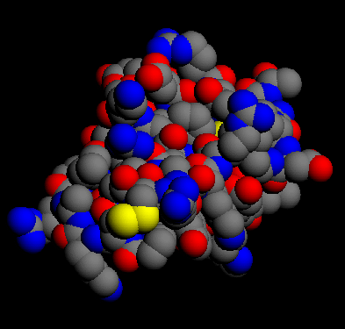
The simplest possible first cell
Chicken and Egg Problem?
580,000 DNA Letters
Vicious Circle!
ATP Synthase Motor
300 Enzymes

Slide 41
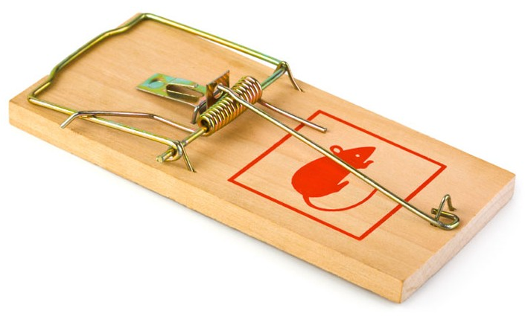
Irreducible Complexity

Slide 42
The ATP Synthase Motor

Slide 43
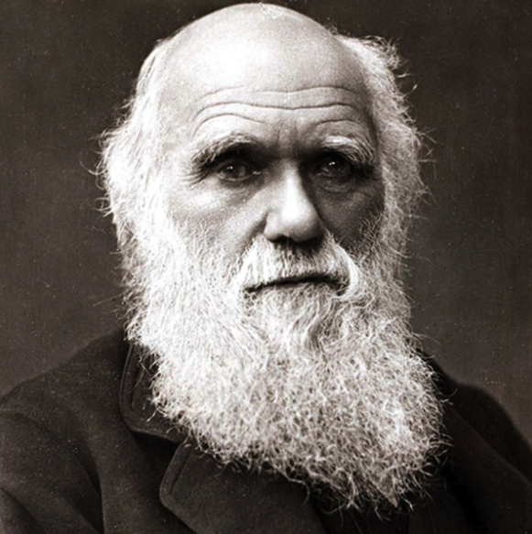
“If it could be demonstrated that any complex organ existed which could not possibly have been formed by numerous, successive, slight modifications, my theory would absolutely break down.”
Charles Darwin
On the Origin of Species

Slide 44
The Design Argument
The cause of the universe must be:
Highly intelligent.
Purposeful.
Conscious, thinking, personal.

Slide 45
The Moral Argument
Every law has a lawgiver.
There is an objective moral law.
Therefore, there must be a moral lawgiver.

Slide 46
Objective Moral Values

Slide 47
Objective Moral Values
Moral
Code

Slide 48
Objective Moral Values

Slide 49
Objective Moral Values
Moral
Code

Slide 50
An Objective Moral Law Exists
Some moral principles are true despite anyone’s opinion.
“It is wrong to torture toddlers to death for fun.”

Slide 51
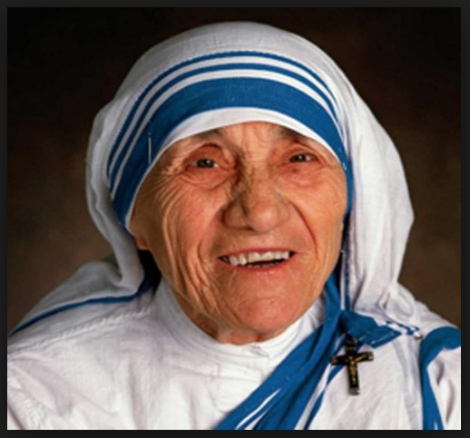
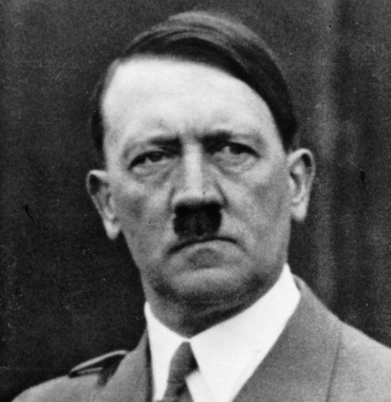
An Objective Moral Law Exists
Some moral principles are true despite anyone’s opinion.
We can’t make moral comparisons without a standard.

Slide 52
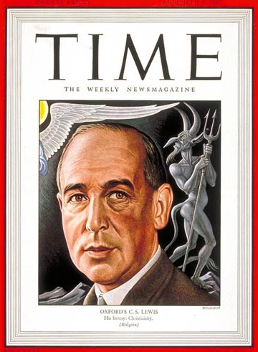
“The moment you say that one set of moral ideas can be better than another, you are, in fact, measuring them both by a standard, saying that one of them conforms to that standard more nearly than the other. But the standard that measures two things is different than either.”
C. S. Lewis
Mere Christianity

Slide 53
An Objective Moral Law Exists
Some moral principles are true despite anyone’s opinion.
We can’t make a moral comparisons without a standard.
To deny absolute moral truth is self-defeating.

Slide 54
Self-Defeating Statements
“It’s wrong for you to tell me what is right and wrong.”
Is it wrong for you to tell me that?

Slide 55
Self-Defeating Statements
“There is no absolute right and wrong for everybody.”
Is that right? For everybody?

Slide 56
An Objective Moral Law Exists
Some moral principles are true despite anyone’s opinion.
We can’t make a moral comparisons without a standard.
To deny absolute moral truth is self-defeating.
We know the moral law by reactions, not actions.
Not by what we do to others…
But by what we want others to do to us.
Moral laws are not defined, but discovered.

Slide 57
Objective Moral Values
Moral
Code

Slide 58
The Moral Argument
The cause of the universe must be:
Absolutely morally pure.
Infinitely loving.
Infinitely just.
Perfectly good.

Slide 59
The Cause of the Universe
Supernatural.
Infinite, without limit.
Eternal, no beginning.
Not physical or material.
Highly powerful.
Highly Intelligent.
Purposeful.
Personal.
Absolutely morally pure.
Infinitely loving.
Infinitely just.
All good.
A Theistic God

Slide 60
The Cause of the Universe
Supernatural. Isaiah 57:15
Infinite, without limit. Psalm 139:7-10
Eternal, no beginning. Psalm 90:2
Not physical or material. John 4:24
Highly powerful. Job 26:14
Highly Intelligent. Isaiah 55:8
Purposeful. Jeremiah 29:11
Personal. Genesis 1:27
Absolutely morally pure. Lev. 19:2
Infinitely loving. John 3:16
Infinitely just. Psalm 89:14
All good. Psalm 107:1
A Theistic God

Slide 61
Other Worldviews
Buddhism: Beginningless and endless universe.
Hinduism: 330 million finite gods, or more.
Sikhism: Synthesis of Hinduism and Islam.
Confucianism: Ethical way of life.
Secular humanism (atheism): No God; Naturalism.
Mormonism: Polytheism; God the Father is finite with a body like a man.
Leaves: Judaism, Islam, and Christianity

Slide 63
Faith
On Solid Ground
https://gregenos.org/hillside/
7/07/24 The Nature of Truth: What is Truth?
7/14/24 The Evidence for the Existence of God
7/21/24 The Historical Reliability of the New Testament
7/28/24 The Evidence for the Resurrection
8/04/24 How Do We Know the Bible is God’s Word?
8/11/24 Why God Allows Evil

